Slide 1



Bitcoin Sentiment Analysis
Analysis and exploration on the nature of the Social Media Interactions around crypto

Slide 2
Bitcoin Sentiment Analysis on Social Media
Introduction
Let’s dive in the fascinating world of the connection between social media sentiment, particularly on Twitter, and the price fluctuations of Bitcoin. Leveraging a comprehensive dataset of approximately 91 million tweets, the aim is to uncover how public perception mirrored in social media can influence or reflect the volatile nature of cryptocurrency markets.
Let’s also take a closer look on how can we fight the misinformation, fraud and scams present in this type of social media content.

Slide 3
DATA SOURCE
The primary dataset for this analysis contains around 91 Million tweets about the most famous cryptocurrency of them all: BITCOIN
This impressive number of interactions around the innovation of the fungible non-physical medium of exchange of value has been collected between the years 2021 and 2023.
The novelty, the feeling of adventure it inspires in some people, and the fear and respect in inspires in others is the main driver of the public discussion about this new asset class.
But even though I am more that sure that you heard murmurs and rumors about this technology…

Slide 4
What Exactly is Bitcoin?
Bitcoin is the first decentralized digital currency, allowing peer-to-peer transactions without a central authority, like a bank or government.
Introduced in a 2008 white paper by an individual or group under the pseudonym Satoshi Nakamoto, its true identity remains a mystery.
It operates on a revolutionary technology called blockchain, a public ledger recording all transactions, ensuring transparency and security.
The first Bitcoin block, known as the Genesis Block, was mined in 2009, marking the start of a new era in digital finance, with Bitcoin evolving from a novel idea to a major financial asset.

Slide 5
From Digital Novelty to Social Media Sensation
2010 - First Real-world Transaction: A pivotal moment in 2010, when 10,000 Bitcoins were famously used to buy two pizzas, showcasing its potential as a viable currency. This is celebrated today as Bitcoin Pizza Day every May 22nd.
2017 - The Bull Run: Bitcoin's value skyrocketed, reaching nearly $20,000 per coin in December 2017, fueling widespread media attention and public discourse.
2021 and Beyond - Institutional Adoption: With major companies and financial institutions embracing Bitcoin, it has become a frequent topic of discussion in social media, reflecting its growing influence in the global financial landscape.

Slide 6
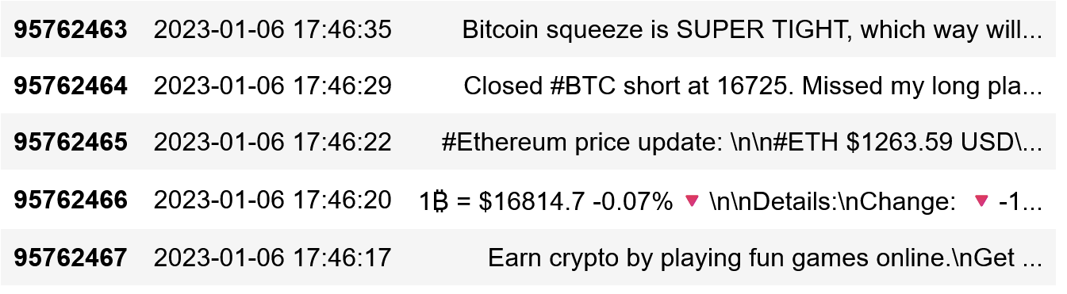
The Social Media Tsunami
How much presence does Bitcoin have in social media? It's not just present; it's a digital juggernaut:
Daily, Bitcoin generates millions of interactions, ranging from tweets, shares, to in-depth discussions, highlighting its enormous footprint in the digital realm.

Slide 7
Navigating the Digital Maze
But while rich in insights, platforms like Twitter are also riddled with great challenges such as:
Misinformation & Noise: Beyond the valuable data lies a clutter of misinformation, irrelevant posts using Bitcoin to gain traction, and the ever-present issue of deciphering what's genuine.
Frauds and Scams: A critical aspect of analysis involves identifying and filtering out numerous frauds and scams that often mar the Bitcoin conversation on these platforms.

Slide 8
Digital Alchemy: Turning Data Chaos into Clarity
Data Analysis: In the complex realm of social media, data analysis emerges as a critical skill for navigating through the noise.
Harnessing Natural Language Processing (NLP): NLP techniques become indispensable in interpreting and understanding the vast array of tweets and posts about Bitcoin.
Clustering for Coherence: By clustering tweets into groups of similar meaning, we create a structured space to discern patterns and insights.

Slide 9
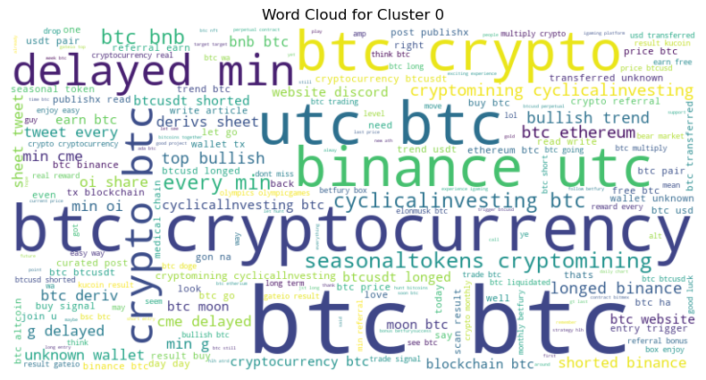
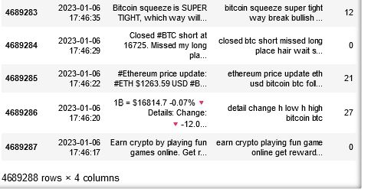
The Visual Journey
That’s how we go from this:
To this:

Slide 10
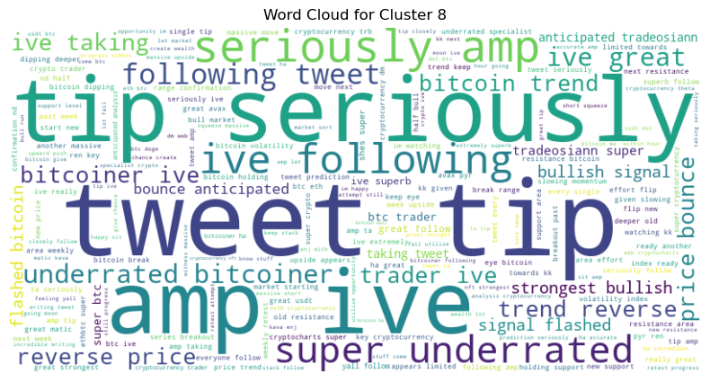
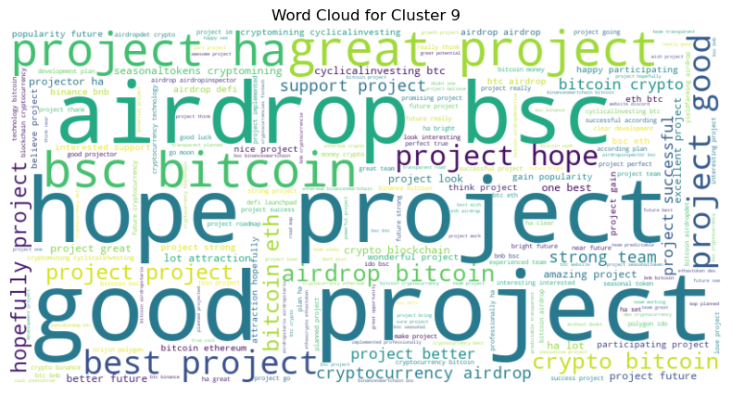
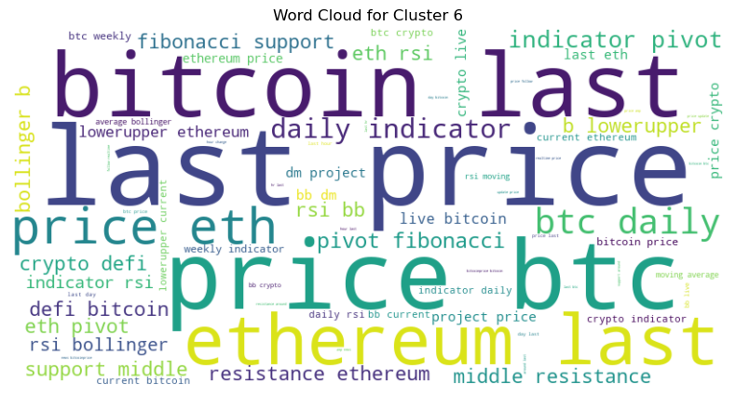
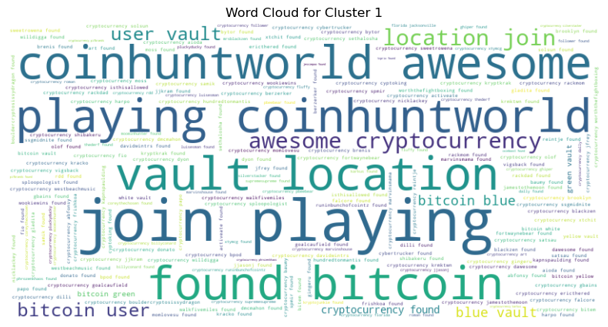
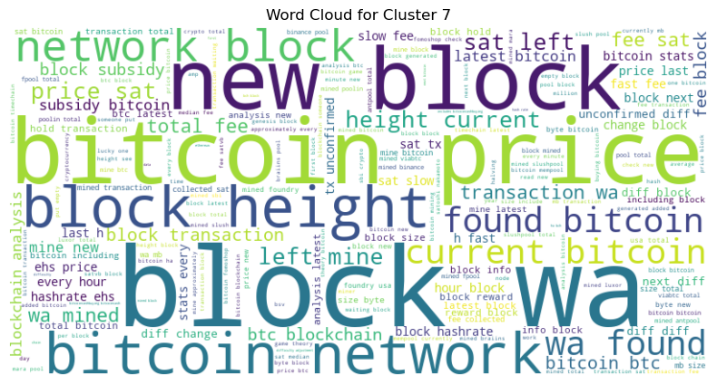
Then From this…

Slide 11
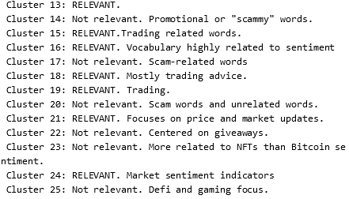
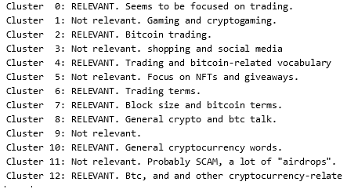
To This…

Slide 12
Decrypting the Dialogue
Are the thousands of conversations around Bitcoin mere noise, or do they hold the key to understanding market trends and sentiments?
An the big question: Does the sheer volume of social media data, once sorted and analyzed, unveil deeper insights into the world of Bitcoin and the broader cryptocurrency market?
Taking as a sample and example the month of December 2022 (a year ago) I tried to analyze this and discovered…

Slide 13
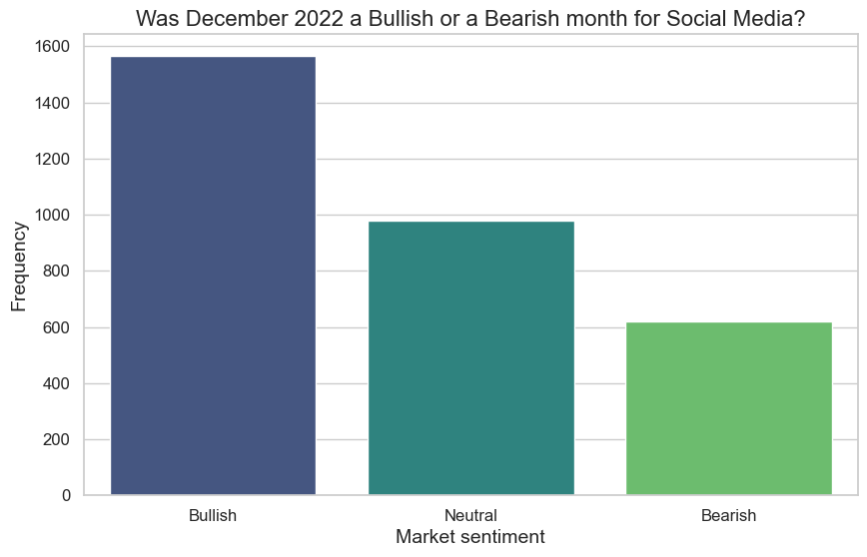

Slide 14
Bulls and Bears: Decoding Market Sentiments
Bullish - The Market Optimists:
Represents a positive outlook on the market.
Investors expect prices to rise and are more likely to buy, driving demand and prices up.
Bearish - The Market Pessimists:
Indicates a negative or cautious stance towards the market.
Investors anticipate a fall in prices, leading to selling off assets, which can drive prices down.

Slide 15
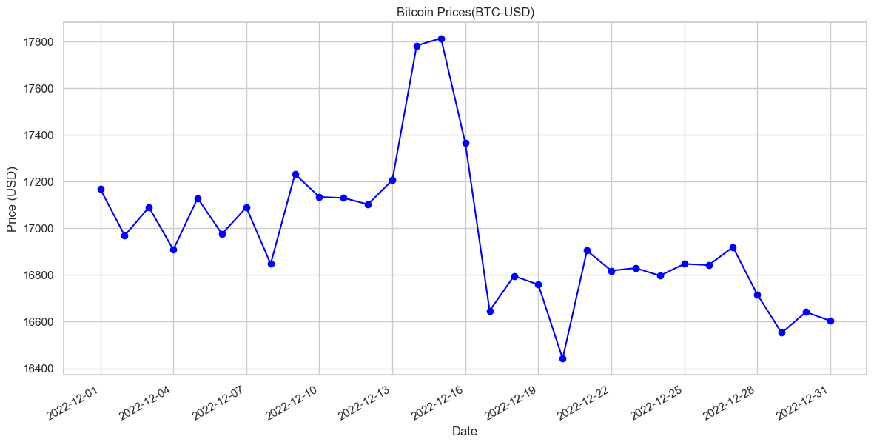
Do these sentiments have any connection to market prices?

Slide 16
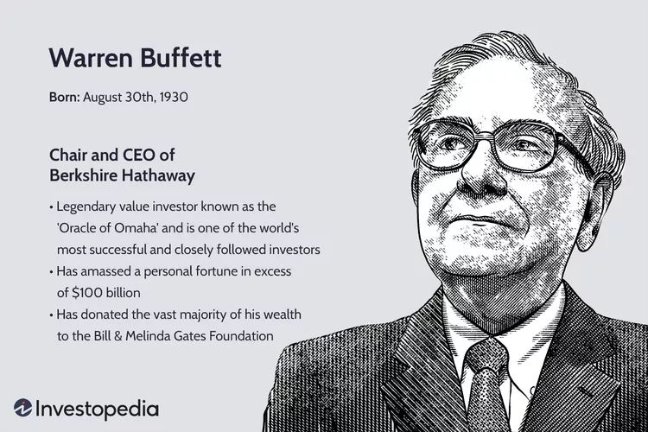
“Be Fearful When Others Are Greedy and Greedy When Others Are Fearful”

